Slide 1
“Project 6 – Scrum 3”
Asmita, Rocco, Samuele
The AQTIVATE project receives funding from the European Union’s HORIZON MSCA Doctoral Networks programme, under Grant Agreement No. 101072344.

Slide 2
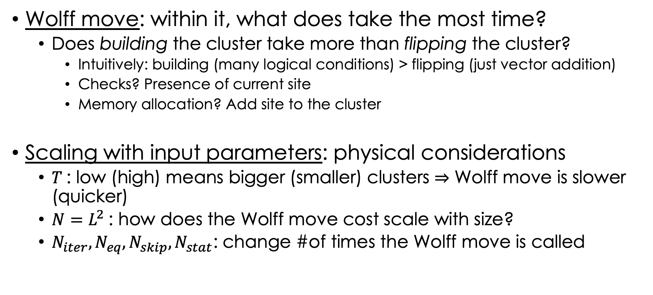
Critical code regions & scaling with parameters
Wolff move: within it, what does take the most time?
Does building the cluster take more than flipping the cluster?
Intuitively: building (many logical conditions) > flipping (just vector addition)
Checks? Presence of current site
Memory allocation? Add site to the cluster
Scaling with input parameters: physical considerations
$T$: low (high) means bigger (smaller) clusters $⇒$ Wolff move is slower (quicker)
$N=L^{2}$: how does the Wolff move cost scale with size?
$N_{iter}, N_{eq},N_{skip},N_{stat}$: change #of times the Wolff move is called

Slide 3
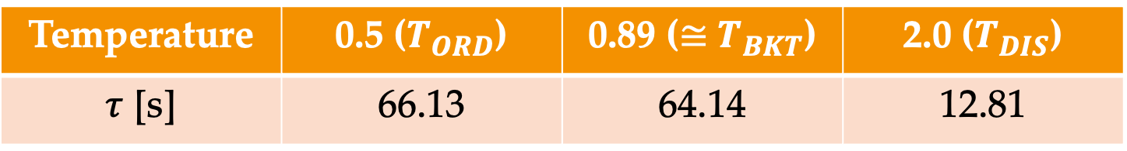
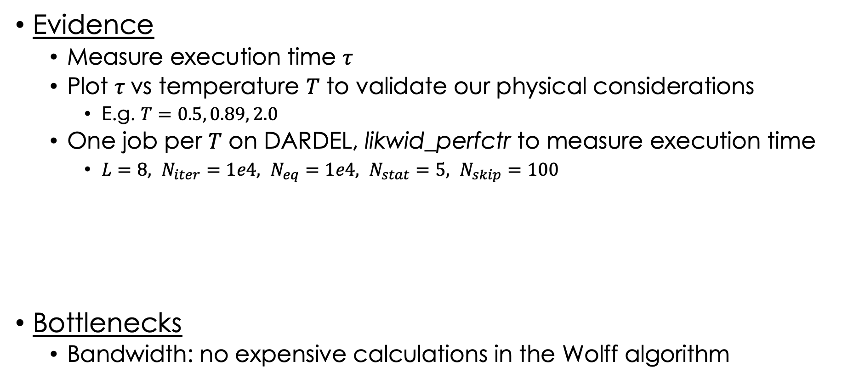
Empirical evidence & Bottlenecks
Evidence
Measure execution time $τ$
Plot $τ$vs temperature $T$ to validate our physical considerations
E.g. $T=0.5, 0.89, 2.0$
One job per $T$ on DARDEL, likwid_perfctr to measure execution time
$L=8, N_{iter}=1e4, N_{eq}=1e4, N_{stat}=5, N_{skip}=100$
Bottlenecks
Bandwidth: no expensive calculations in the Wolff algorithm
Temperature | 0.5 ($T_{ORD}$) | 0.89 ($≅$ $T_{BKT}$) | 2.0 ($T_{DIS}$)
$τ$ [s] | 66.13 | 64.14 | 12.81

Slide 4
Thank you

Slide 5
Thank you for Scrum #2

